Slide 1

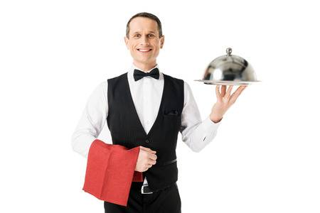
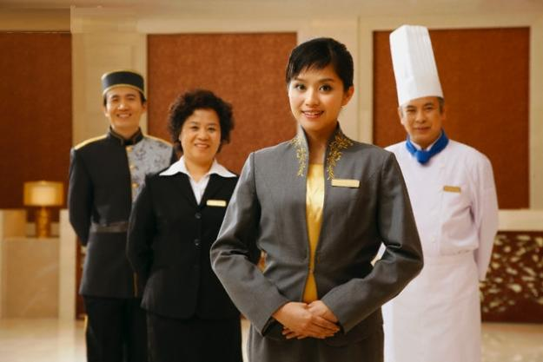
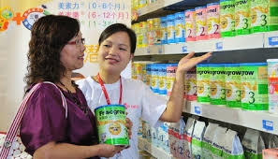
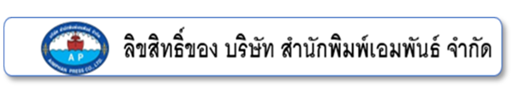
Unit 6
In Work Situations(Part I)
Secretary
Waitperson
Sales Assistant
Hotel manager

Slide 2


Secretary
Secretary means a person who works in an office, working for another person, dealing with mail and phone calls, keeping records, arranging meetings with people, etc.
Please contact my secretary to make an appointment.
I’m working as a secretary of the Vice President of a company.

Slide 3





SECRETARY: JOB DESCRIPTION
answering calls, taking messages and handling correspondence
maintaining diaries and arranging appointments
typing, preparing and collating reports
filing
Simple PowerPoint

Slide 4

SECRETARY: JOB DESCRIPTION
organising and servicing meetings(producing agendas and taking minutes)
implementing new procedures and administrative systems
coordinating mail-shots and similar publicity tasks
acting as a receptionist and/or meeting and greeting clients
“Reference ” https://targetjobs.co.uk/careers-advice/job-descriptions/278955-secretary-job-description
Simple PowerPoint

Slide 5
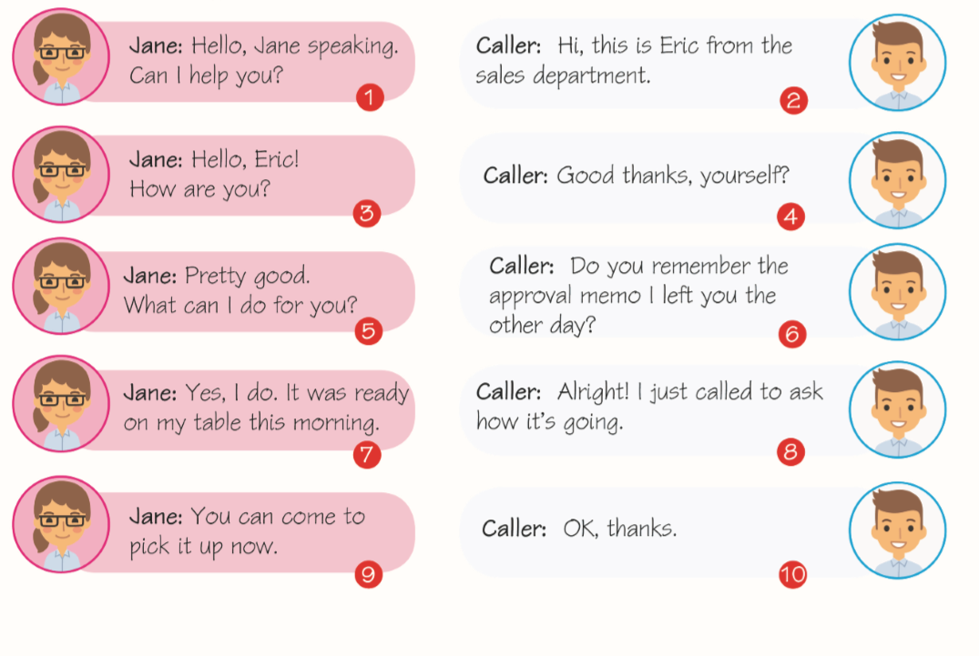

Conversation: Secretarial tasks on the telephone conversation

Slide 6
Vocabulary: Arranging an appointment(Verb)
have an appointment
make an appointment
cancel an appointment
นัดหมาย
นัดหมาย
ยกเลิกนัดหมาย
postpone an appointment
miss an appointment
keep an appointment
เลื่อนนัดหมาย
พลาดนัดหมาย
ไปตามที่นัดหมาย

Slide 7

Expression: Making an appointment
Examples
Would you like to arrange an appointment to see Khun Dumrong?
When can you come and see Khun Dumrong?
Is ten o’clock on Monday convenient for you?
Content Here
You can simply impress your audience and add a unique zing and appeal to your Presentations. Easy to change colors, photos and Text.
Do you have an appointment with Khun Dumrong?
You can meet the president by appointment only.
How about next Tuesday?

Slide 8



Expression: Cancel or Postpone an Appointment
Examples
I’m afraid I can’t come on Monday morning. I’ve already got a meeting at that time.(cancellation)
My schedule’s very busy tomorrow. I can’t join the meeting tomorrow. (cancellation)
I had to postpone my appointment in the morning because I’m late. (postponement)
Can I see you at 3 o’clock? I have another meeting at 2.30.
(postponement)

Slide 9
Expression: Responses to the appointment
That’ll be fine.
Examples
Any time’s OK.
Let me see. No, I’m sorry. I’ve already got an appointment at that time.
Let me see. I’m afraid. The president is out of the office.
I’m afraid I can’t make it.
I don’t think I’ll be able to make it to the party on Sunday.

Slide 10
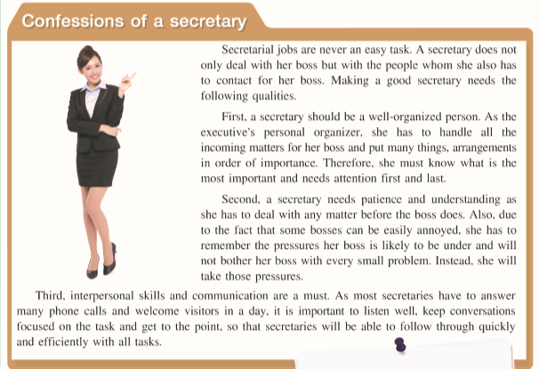
Reading comprehension: How to be a qualified secretary
คุณสมบัติ
บริหารจัดการ
การสื่อสาร
ความอดทน
ความกดดัน
ทักษะการสื่อสารระหว่างบุคคล

Slide 11
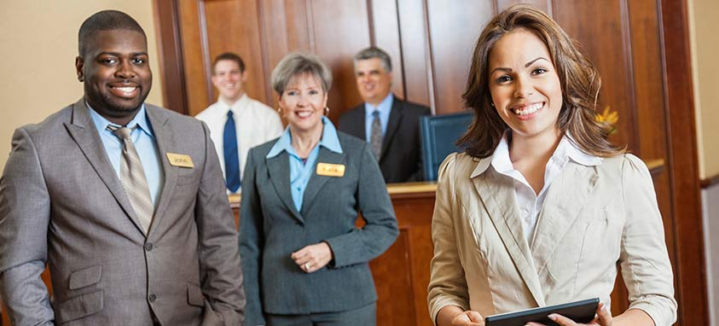
Hotel manager
Hotel managers are responsible for managing employees and for planning, marketing, coordinating and administering hotel services such as catering and accommodation facilities.

Slide 12
HOTEL MANAGER: JOB DESCRIPTION
Typical responsibilities include:
recruiting, training and supervising staff
managing budgets
maintaining statistical and financial records
planning maintenance work, events and room bookings
handling customer complaints and queries
promoting and marketing the business
“Reference” https://targetjobs.co.uk/careers-advice/job-descriptions/279789-hotel-manager-job-description
ensuring compliance with health and safety legislation and licensing laws

Slide 13
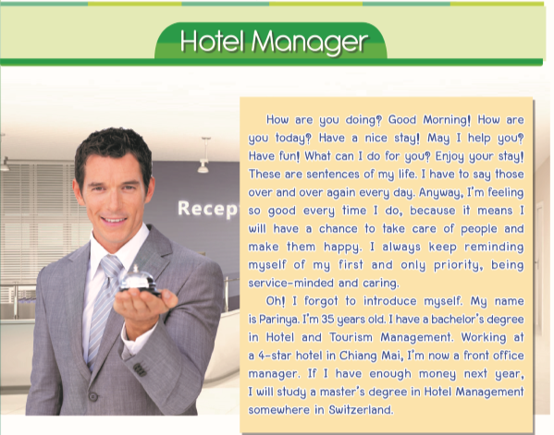
Reading comprehension: Hotel manager Parinya

Slide 14
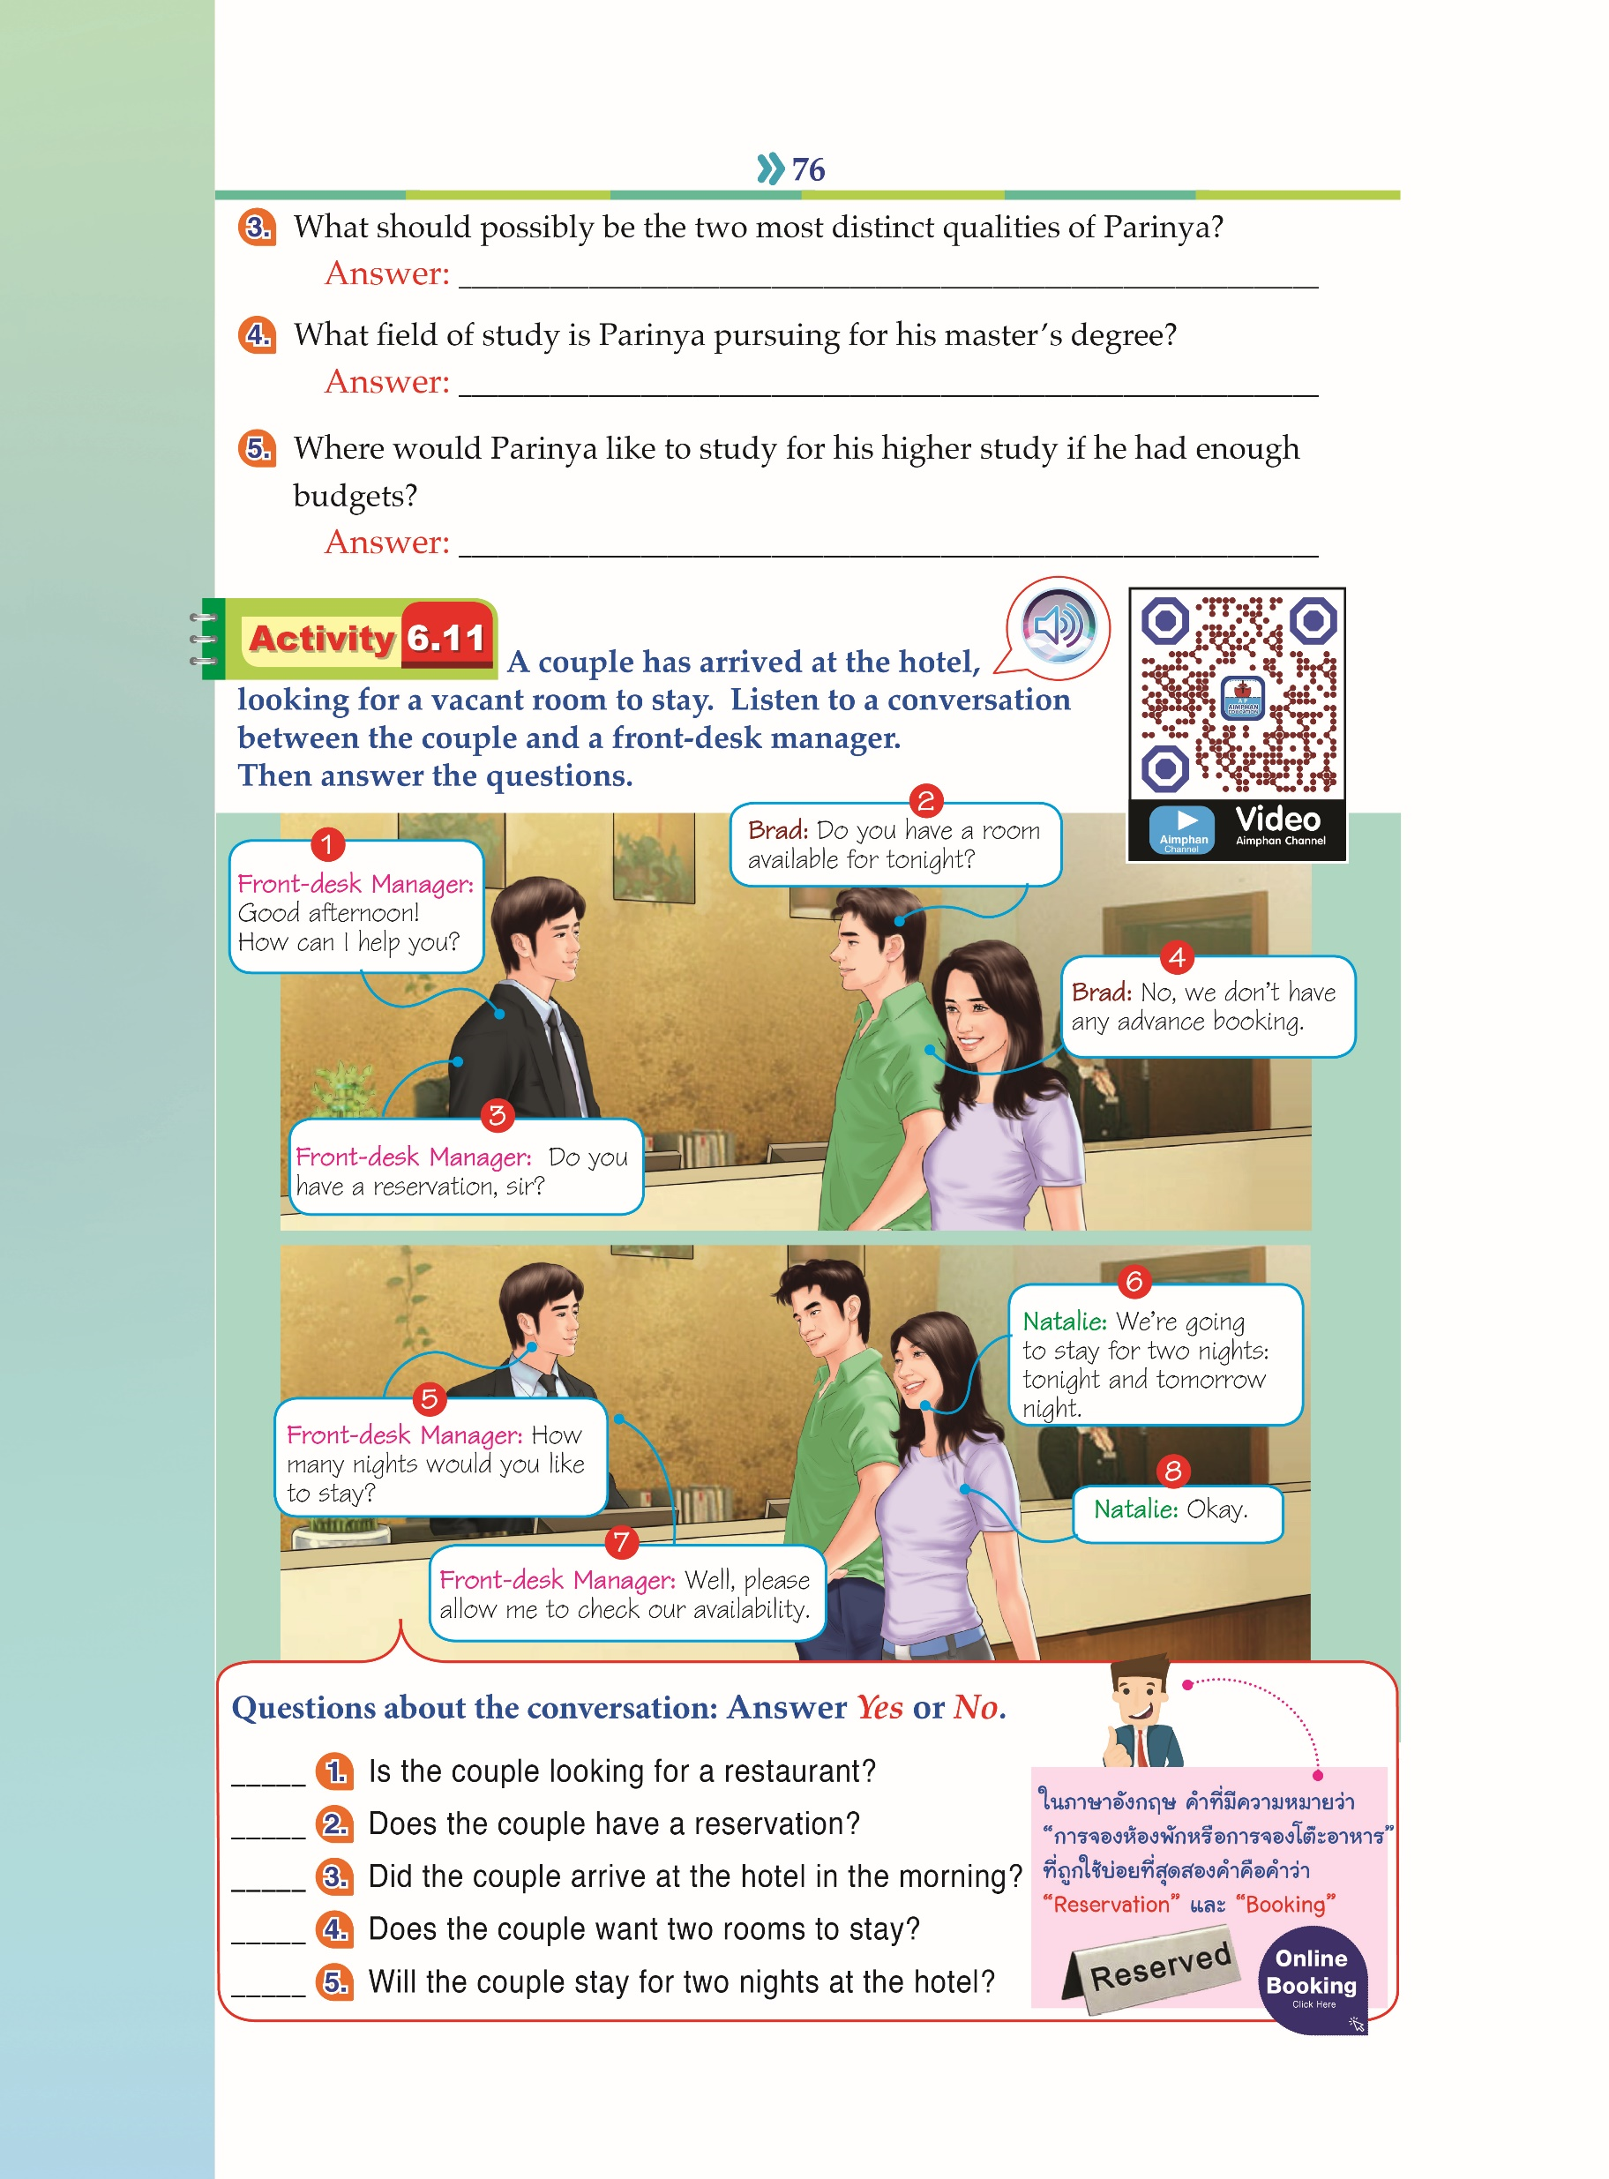
Conversation: At the front desk(1)

Slide 15
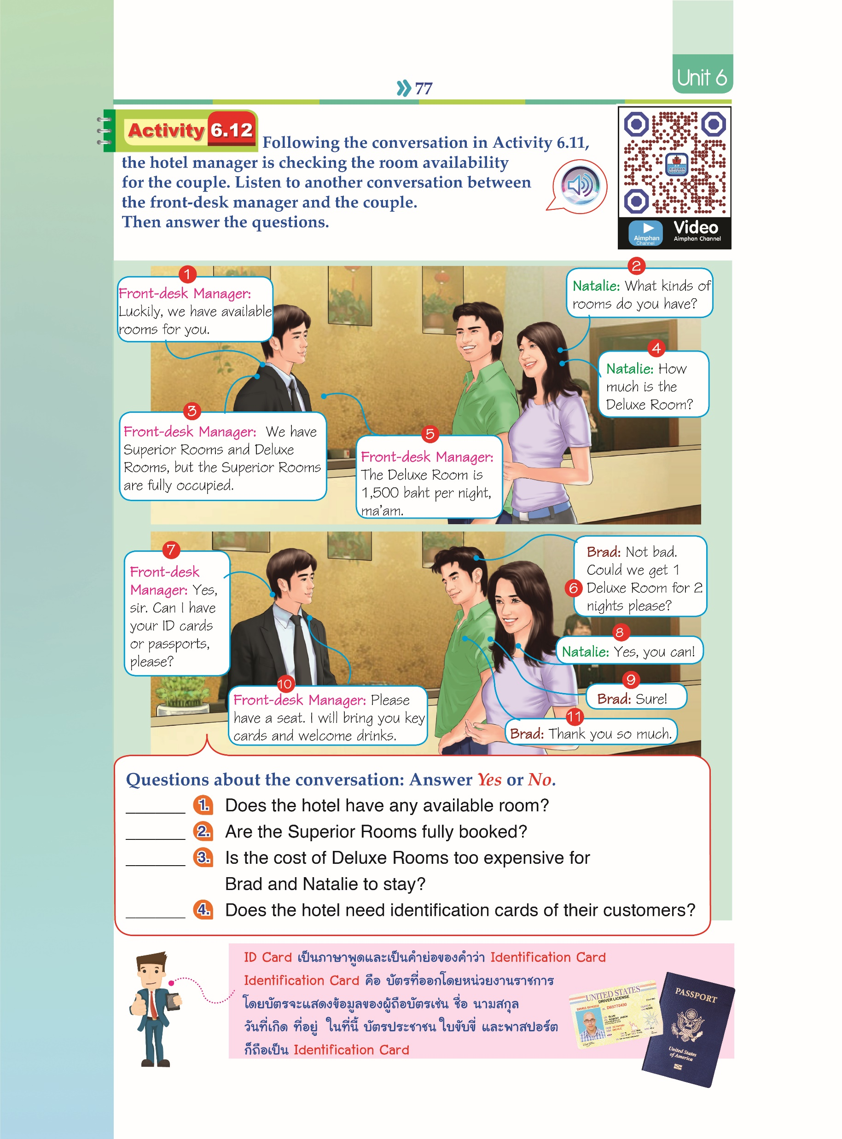
Conversation: At the front desk(2)

Slide 16
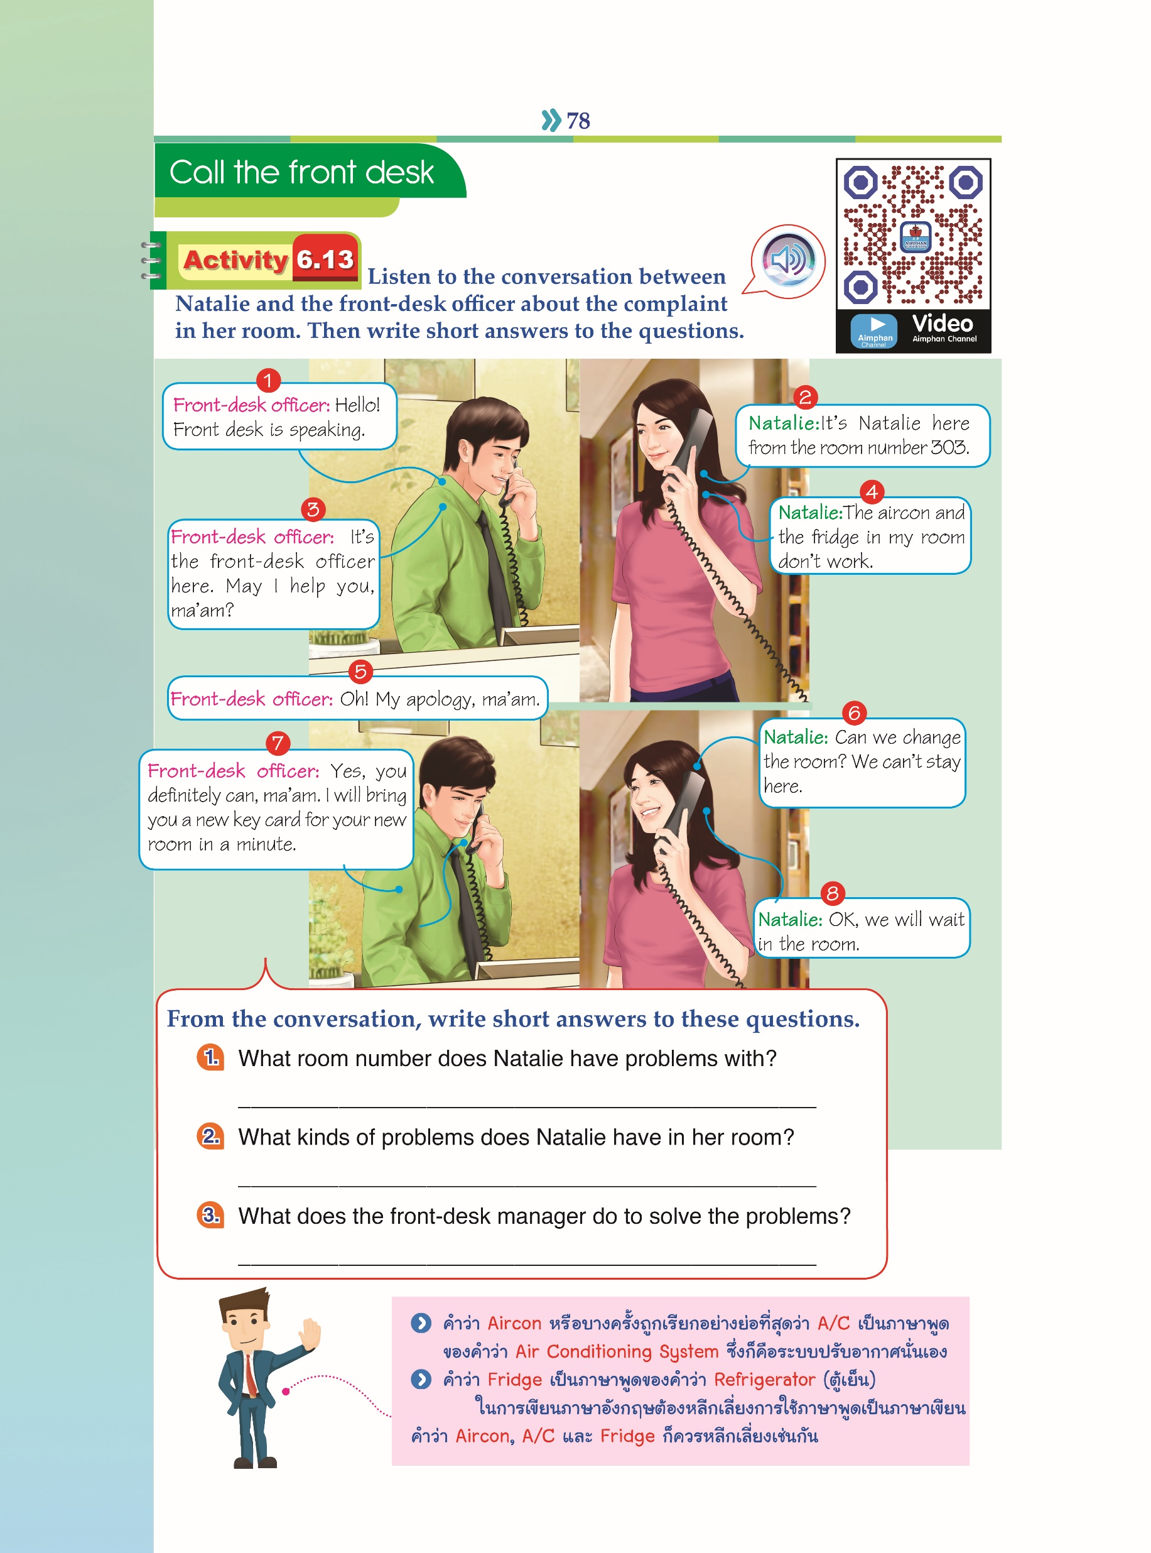
Conversation: At the front desk(3)

Slide 17
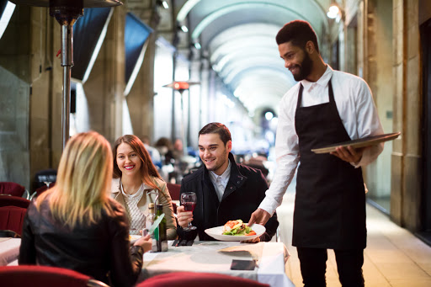
Waitperson
Waitpersons refer to waiters or waitresses who are responsible for taking orders and serving food and beverages to guests. They play an important role in guest satisfaction as they are also responsible for checking on customers to ensure that they are enjoying their meals and take action to correct any problems.

Slide 18

WAITPERSON: JOB DESCRIPTION
Typical responsibilities include:
Provide excellent customer services. | Arrange table settings.
Always strive towards best customer satisfaction. | Keep tables clean and tidy at all times.
Greet customers and present menus. | Check products for quality.
Make suggestions based on their preferences. | Deliver checks and collect payments.
Take and serve food/drinks orders. | Cooperate and communicate with all serving and kitchen staff.
Up-sell when appropriate. “Reference” https://www.talentlyft.com/en/resources/waiter-or-waitress-job-description | Adhere to all relevant health department rules/regulations and all customer service guidelines.

Slide 19
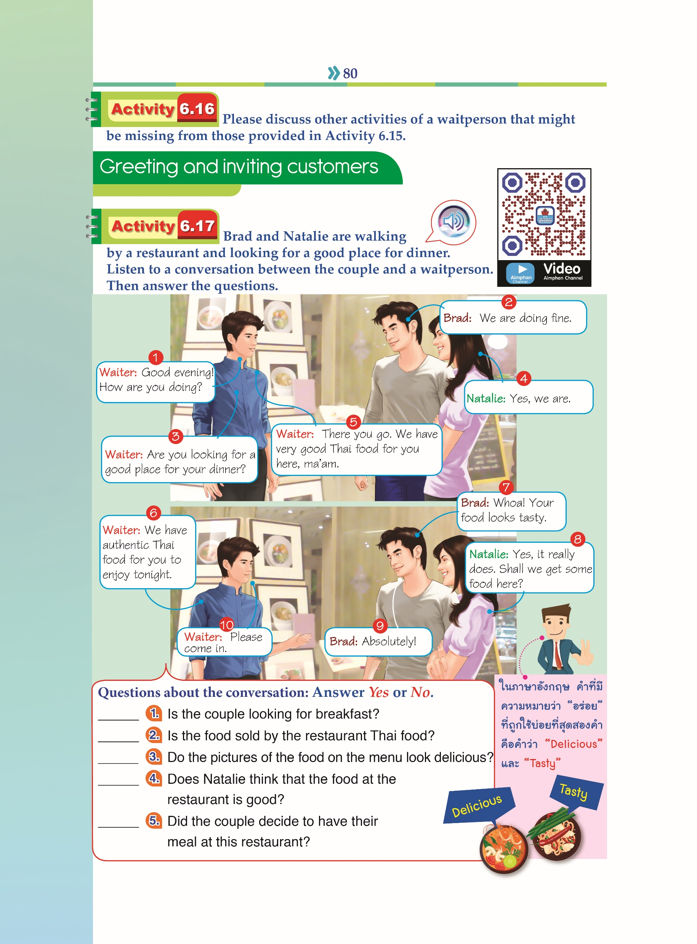
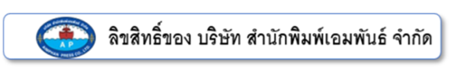
Conversation: At the restaurant(1)

Slide 20
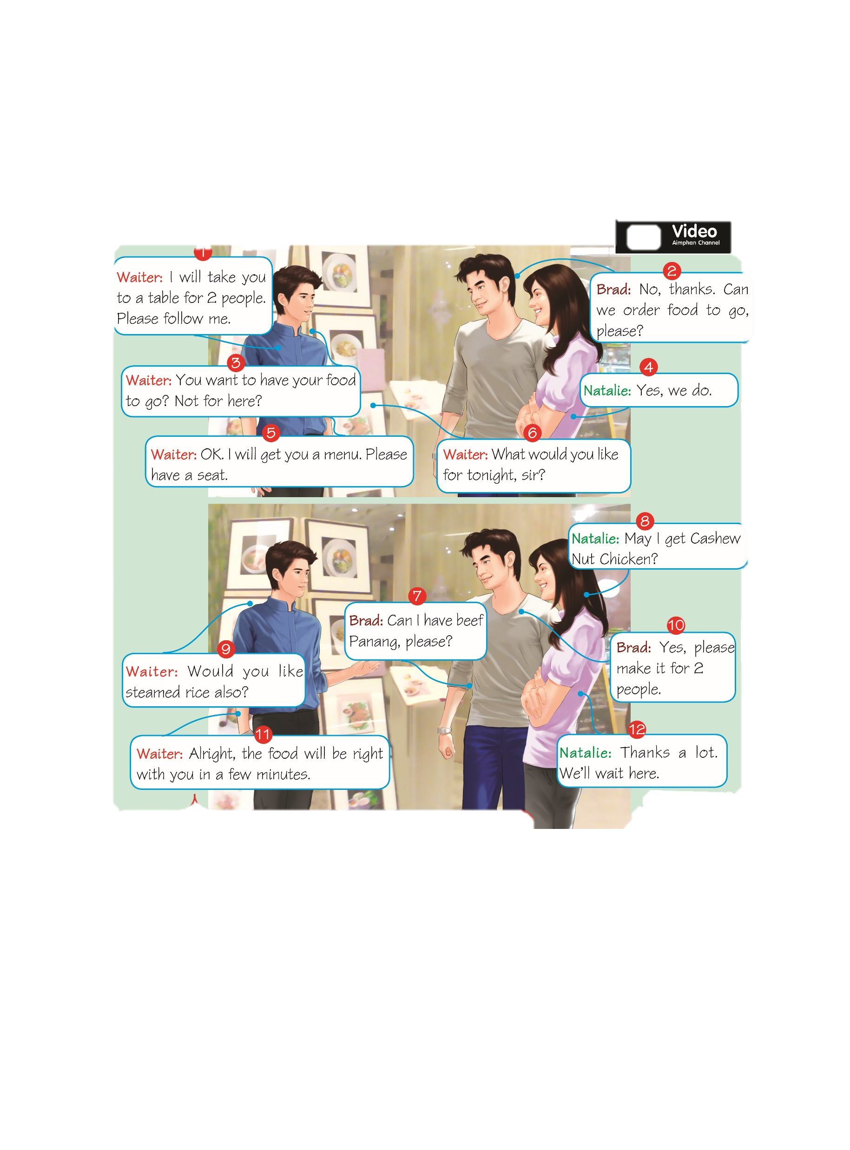
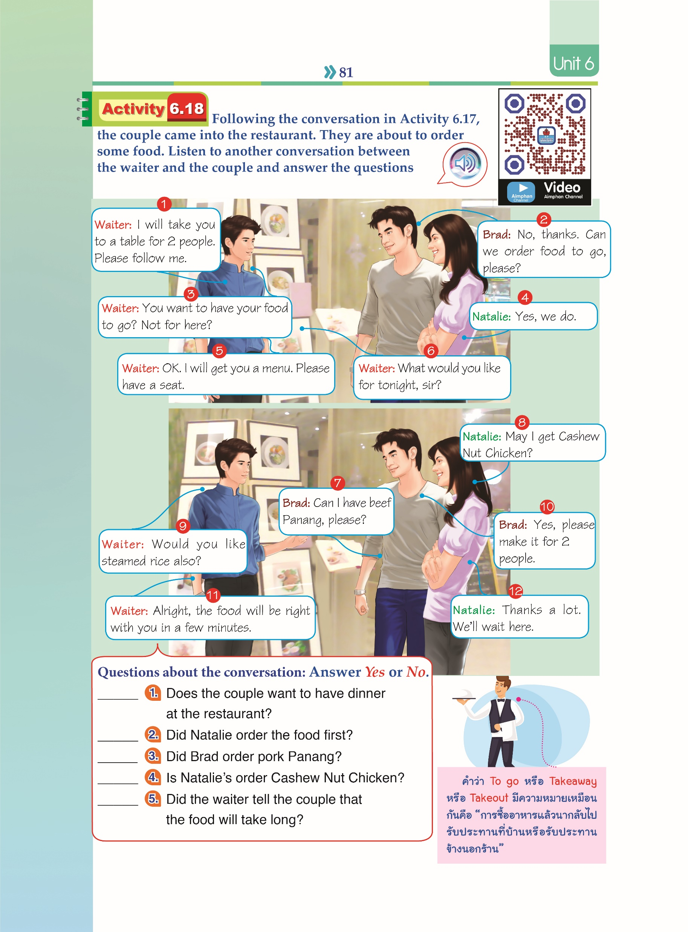
Conversation: At the restaurant(2)

Slide 21
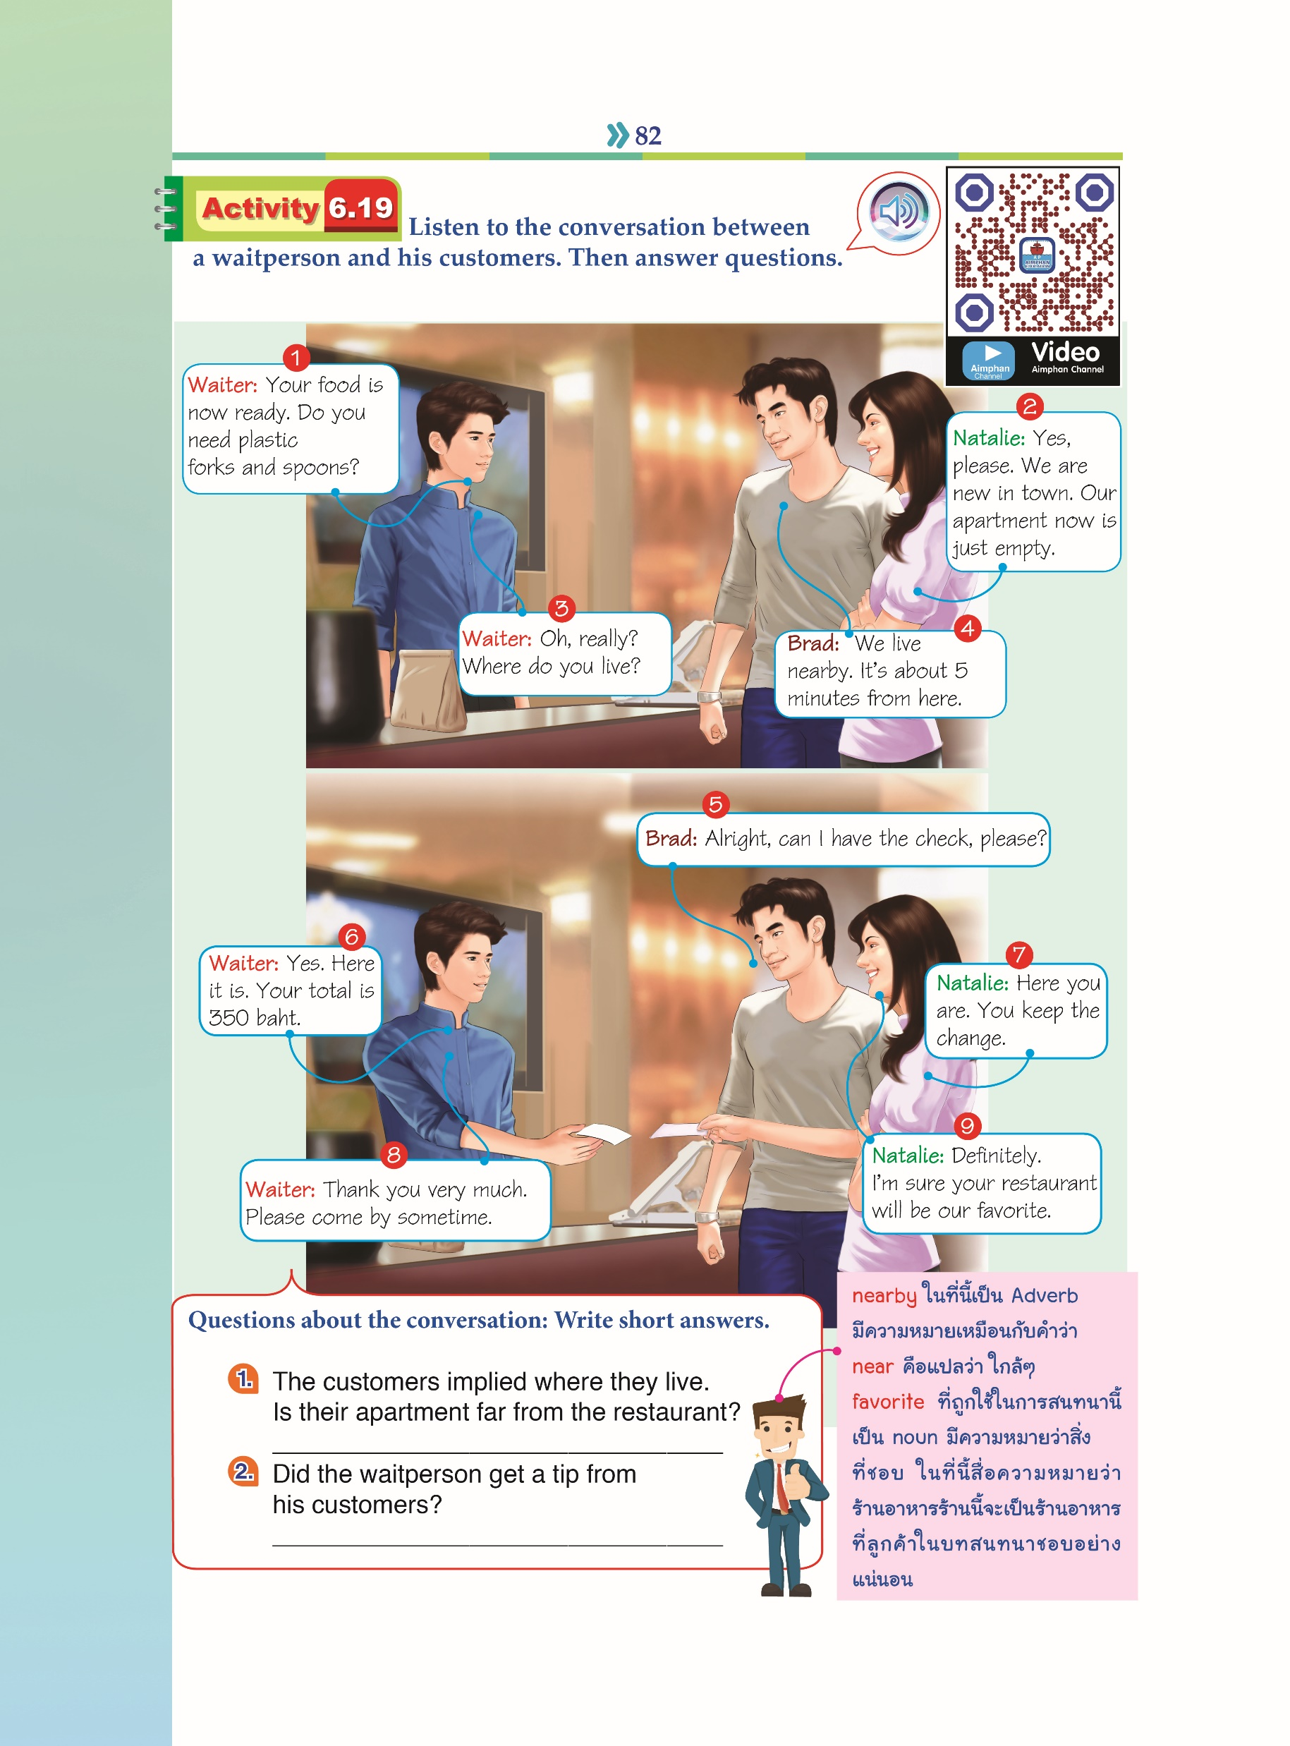
Conversation: At the restaurant(3)

Slide 22
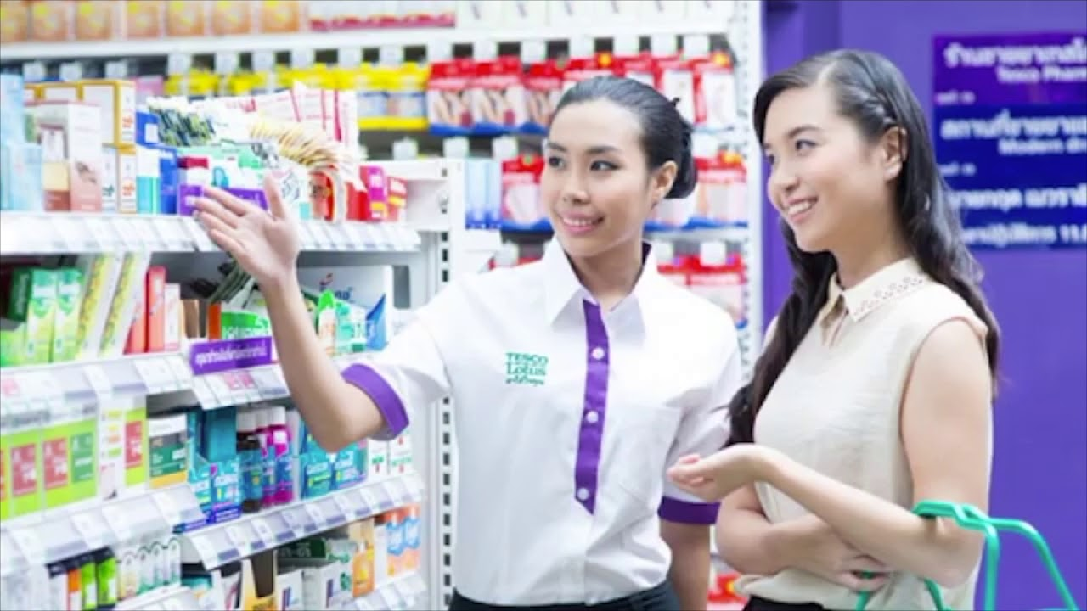

Sales Assistant
Sales Assistants work on store sales floors providing assistance directly to customers. They must be knowledgeable of the store layout, inventory and company policies in order to provide accurate information to shoppers. A Sales Assistant will help locate product for customers, place order, place holds, process transactions and keep the sales floor organized and well-stocked. They are the face of the company and must uphold company values both in how they dress and how they interact with customers.

Slide 23
Sales Assistant
Typical responsibilities of the job include:
Organize sales presentations and ensure that all sales presentation materials are prepared prior to deadlines.
Update customer records in the company database as required.
Contact customers to answer basic procedural questions or to gauge their level of satisfaction with the company.
Collaborate with the sales staff to monitor active purchase orders and make sure that orders are completed on time.
Report any inventory or service issues to management and the appropriate Account Manager immediately. “Reference” https://www.indeed.com/hire/job-description/sales-assistant

Slide 24
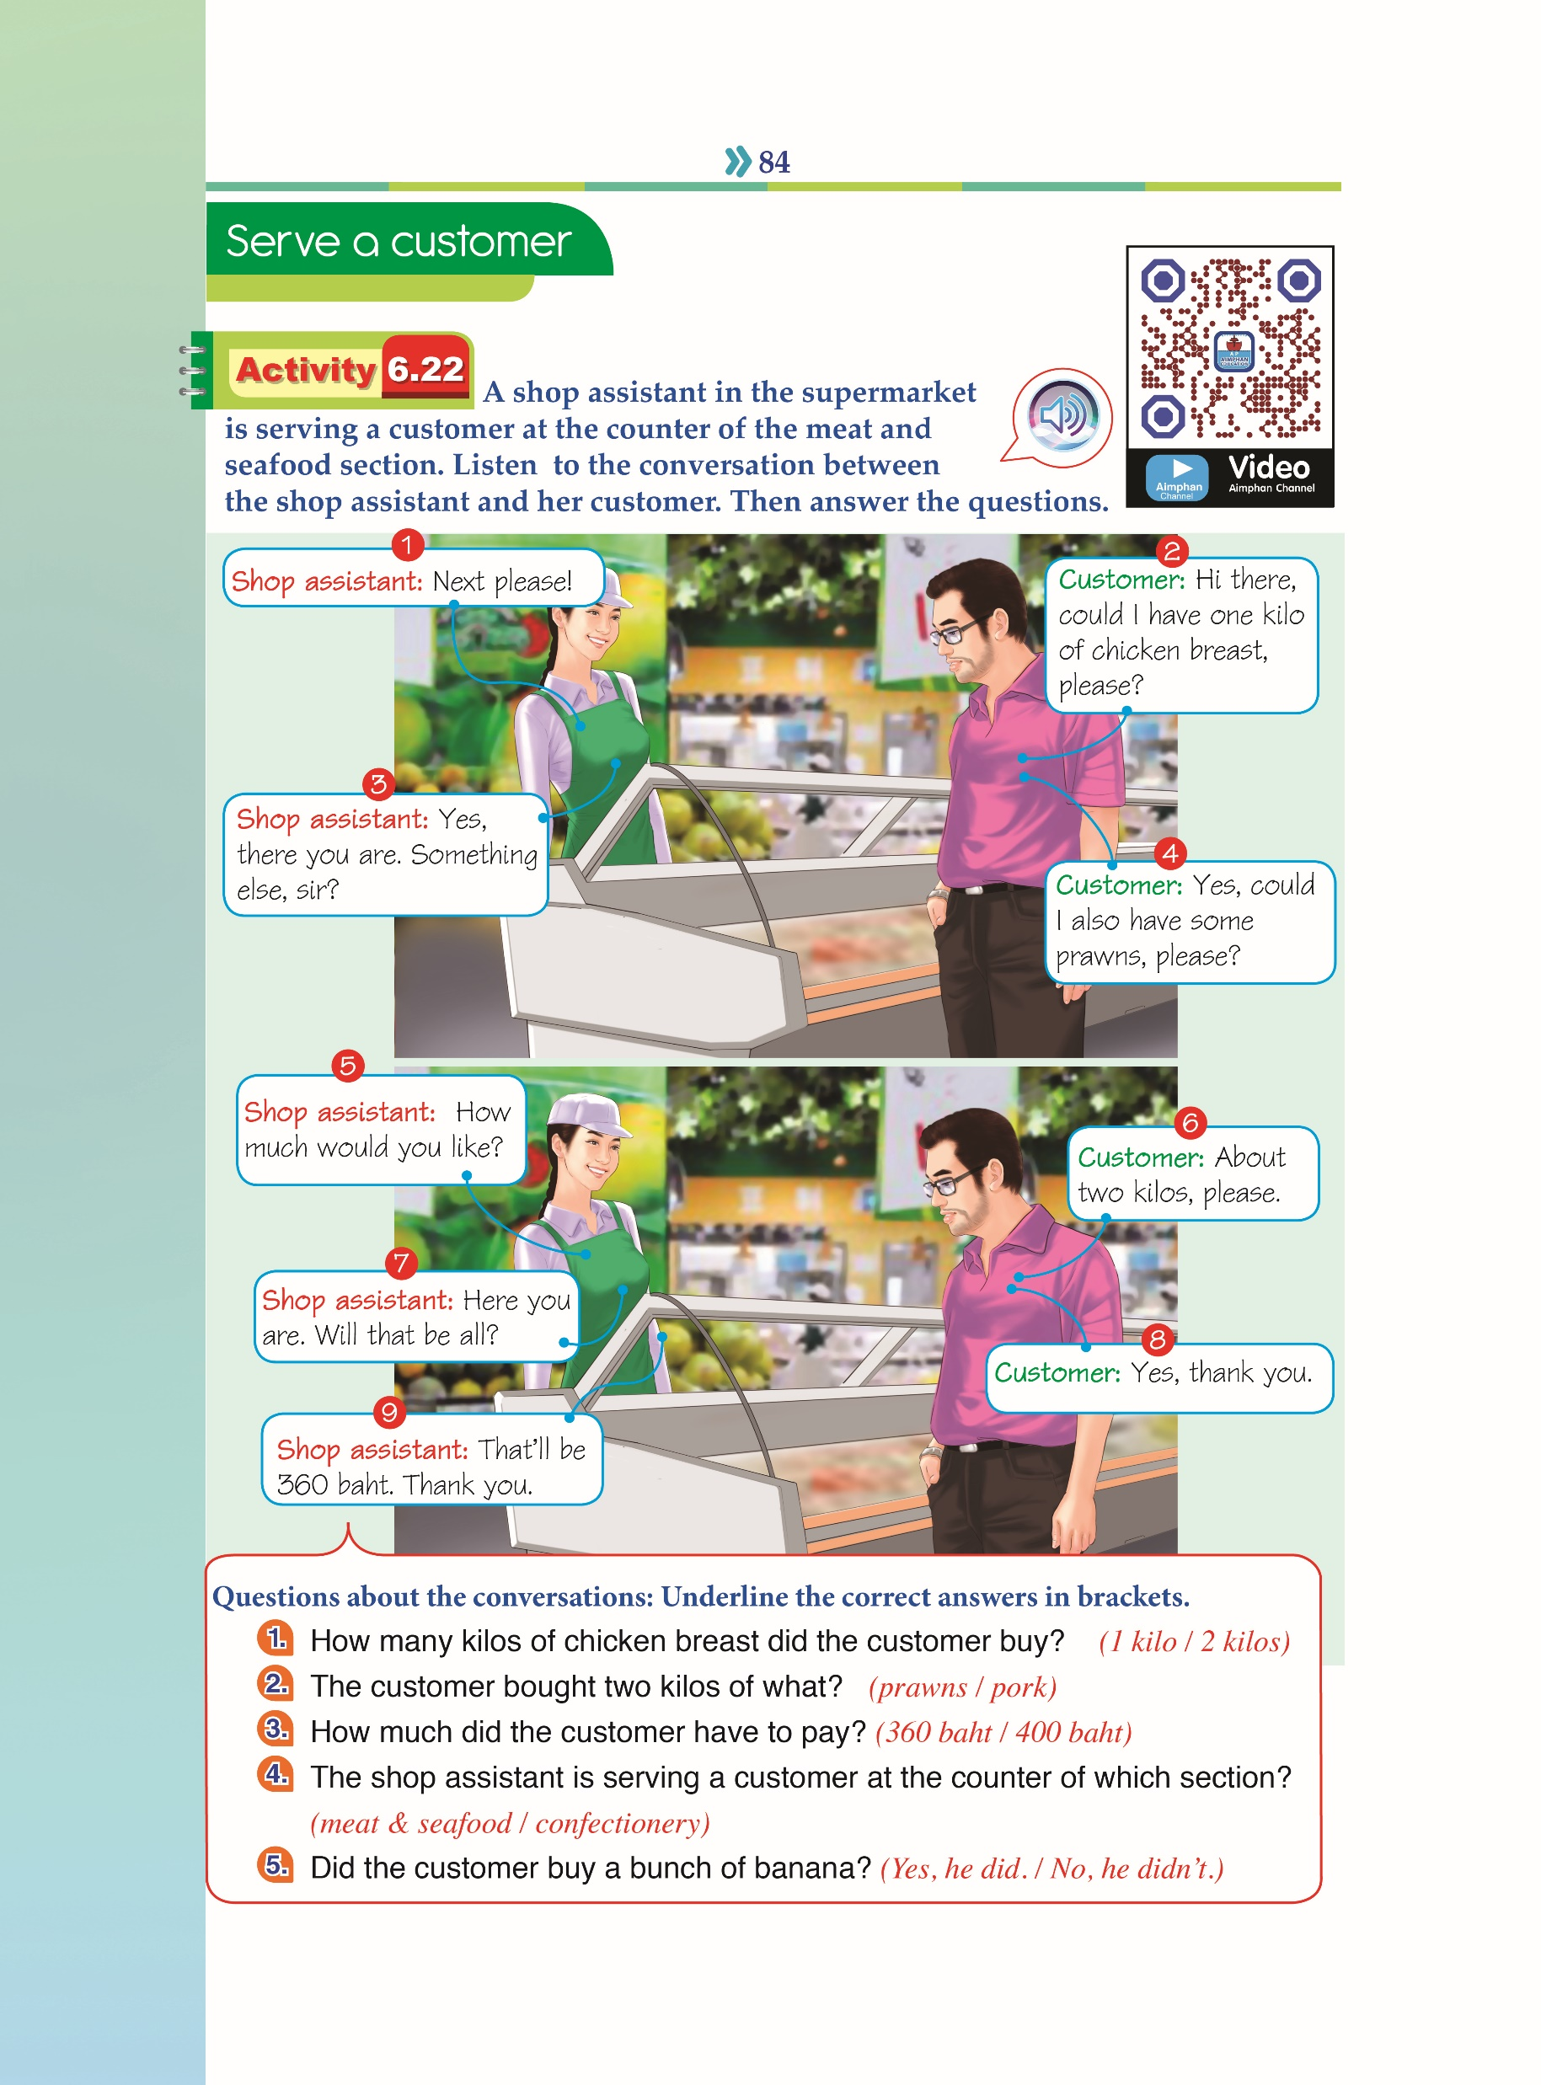
Conversation: At the supermarket(1)

Slide 25
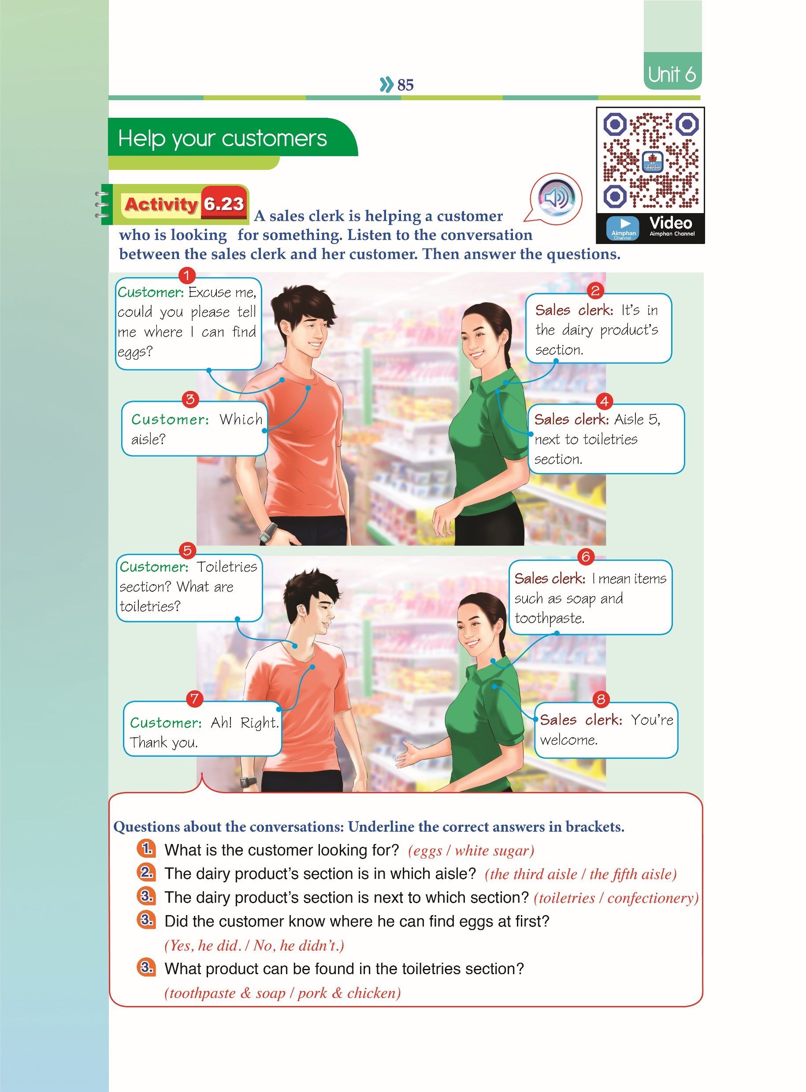
Conversation: At the supermarket(2)

Slide 26
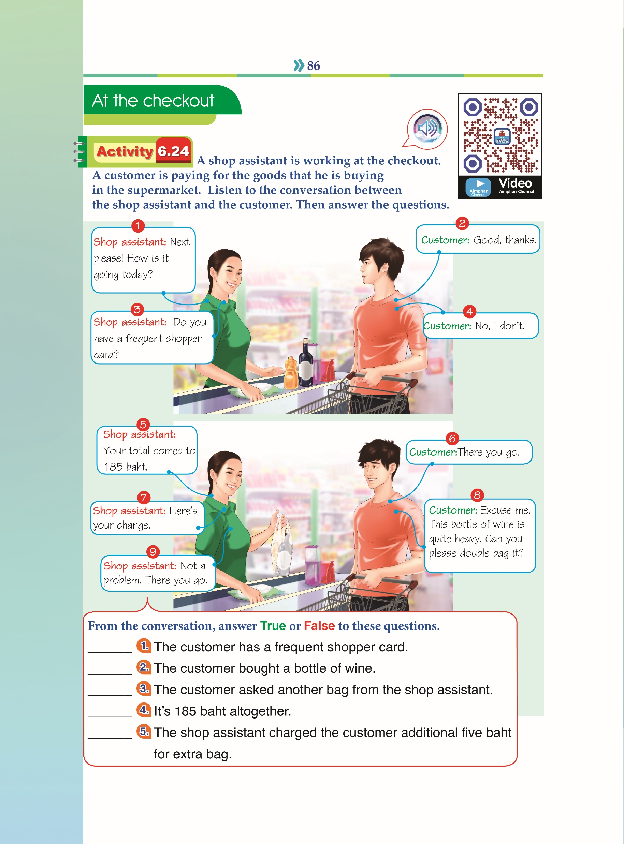

Conversation: At the checkout(3)

