Slide 1
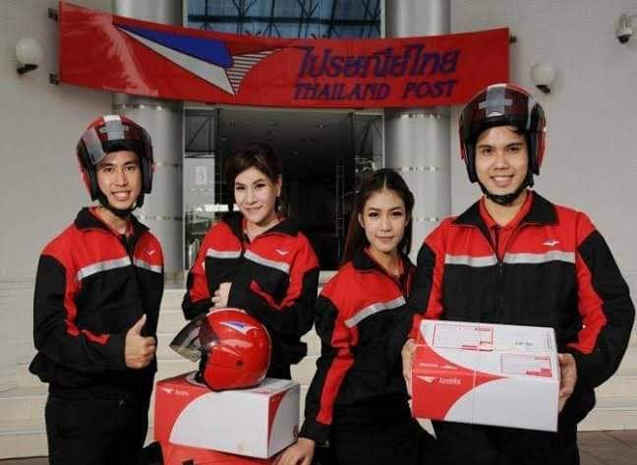
Unit 7
In Work Situations
(Part II)
IT officer
Nurse
Salesperson
Postal worker

Slide 2
IT officer
The IT Support team maintains the computer networks of all types of organisations, providing technical support and ensuring the whole company runs smoothly. IT Support monitors and maintains the company computer systems, installs and configures hardware and software, and solves technical problems.
Manager
Text Here

Slide 3
IT OFFICER: JOB DESCRIPTION
Typical responsibilities of the job include:
Installing and configuring computer hardware, software, systems, networks, printers and scanners
Monitoring and maintaining computer systems and networks
Responding in a timely manner to service issues and requests
Providing technical support across the company (this may be in person or over the phone)
Setting up accounts for new users
Repairing and replacing equipment as necessary
Testing new technology
Possibly training more junior staff members
Reference: https://www.roberthalf.com.au/employers/it-technology/help-desk-jobs

Slide 4
Reading comprehension: IT officer Toon

Slide 5
Conversation: At the IT Support department(1)

Slide 6
Conversation: At the IT Support department(2)

Slide 7
Conversation: At the IT Support department(3)

Slide 8
Nurse
Nurses plan and provide medical and nursing care to patients in hospitals, at home or in other settings who are suffering from chronic or acute physical or mental ill health.
Manager
Text Here

Slide 9
NURSE: JOB DESCRIPTION
Agenda Style
Typical responsibilities of the job include:
01
Contents
Identifying patients’ care requirements, focus on their needs and act on them.
Get a modern PowerPoint Presentation that is beautifully designed. I hope and I believe that this Template will your Time.
02
Contents
Nurturing a compassionate environment by providing psychological support.
Get a modern PowerPoint Presentation that is beautifully designed. I hope and I believe that this Template will your Time.
03
Contents
Resolving or reporting on patients’ needs or problems.
Get a modern PowerPoint Presentation that is beautifully designed. I hope and I believe that this Template will your Time.
Reference: https://targetjobs.co.uk/careers-advice/job-descriptions/276221-nurse-job-description
Get a modern PowerPoint Presentation that is beautifully designed. I hope and I believe that this Template will your Time.

Slide 10
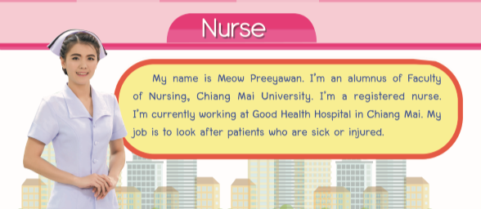
Reading comprehension: Nurse Meow

Slide 11
Conversation: At the hospital(1)

Slide 12
Conversation: At the Department of Internal Medicine(2)

Slide 13
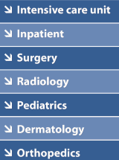
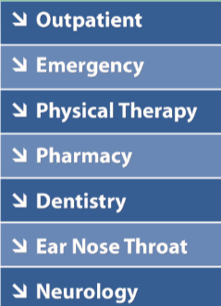
Departments in a hospital

Slide 14
Salesperson
Salesperson or sales representative are the principal point of contact between a business and its customers. Sales reps ensure current customers have the right products and services, identify new markets and customer leads, and pitch prospective customers. In many ways the face of the company, sales representatives may do everything from answering phones to monitoring the competition, all while maintaining good customer relations and pursuing new sales opportunities.
Manager
Text Here

Slide 15
SALESPERSON: JOBDESCRIPTION(1)
Typical responsibilities of the job include:
Serves customers by selling products and meeting customer needs.
Services existing accounts, obtains orders, and establishes new accounts by planning and organizing daily work schedule to call on existing or potential sales outlets and other trade factors.
Adjusts content of sales presentations by studying the type of sales outlet or trade factor.
Focuses sales efforts by studying existing and potential volume of dealers.
Submits orders by referring to price lists and product literature. Keeps management informed by submitting activity and results reports, such as daily call reports, weekly work plans, and monthly and annual territory analyses.

Slide 16
SALESPERSON: JOBDESCRIPTION(2)
Typical responsibilities of the job include:
Monitors competition by gathering current marketplace information on pricing, products, new products, delivery schedules, and merchandising techniques.
Recommends changes in products, service, and policy by evaluating results and competitive developments
Resolves customer complaints by investigating problems, developing solutions, preparing reports, and making recommendations to management.
Maintains professional and technical knowledge by attending educational workshops, reviewing professional publications, establishing personal networks, and participating in professional societies. Provides historical records by maintaining records on area and customer sales. Contributes to team effort by accomplishing related results as needed.
Reference: https://hiring.monster.com/employer-resources/job-description-templates/sales-representative-job-description-sample/

Slide 17
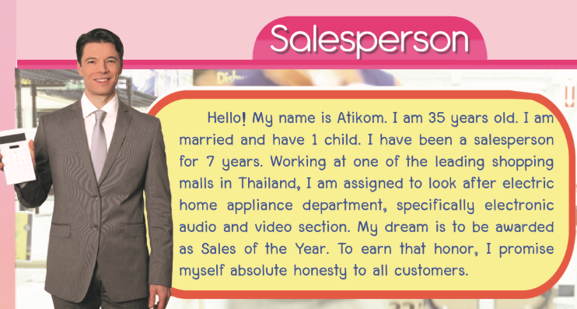
Reading comprehension: Salesperson Atikom

Slide 18
Conversation: At the department store

Slide 19
Vocabulary: Documents used in selling and buying goods
Packing list
Receipt
Invoice
Purchase order
Proof of delivery
ใบแสดงรายการบรรจุหีบห่อ
ใบเสร็จรับเงิน
ใบแจ้งหนี้
ใบแจ้งหนี้
ใบส่งสินค้า

Slide 20
Postal worker
Postal service workers sell postal products and collect, sort, and deliver mail.
Manager
Text Here

Slide 21
POSTAL WORKER: JOB DESCRIPTION
Typical responsibilities of the job include:
Collect letters and parcels. Sort incoming letters and parcels. Sell stamps and other postal products. Get customer signatures for registered, certified, and insured mail. Operate various types of postal equipment. Distribute incoming mail from postal trucks.
Reference: https://www.truity.com/career-profile/postal-service-worker

Slide 22
Reading comprehension: Postal worker Aranya

Slide 23
Conversation: At the post office(1)

Slide 24
Conversation: At the post office(2)

