Slide 1
Unit 8
Communication & IT at Work

Slide 2
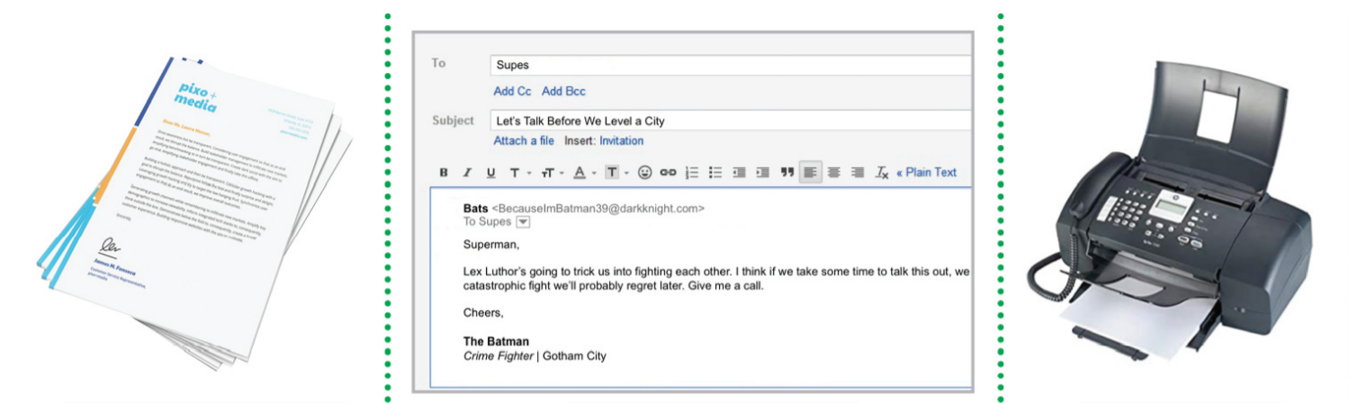
Vocabulary: Written communication
letter
e-mail
fax

Slide 3
Vocabulary: Written communication
memo
report
notice

Slide 4
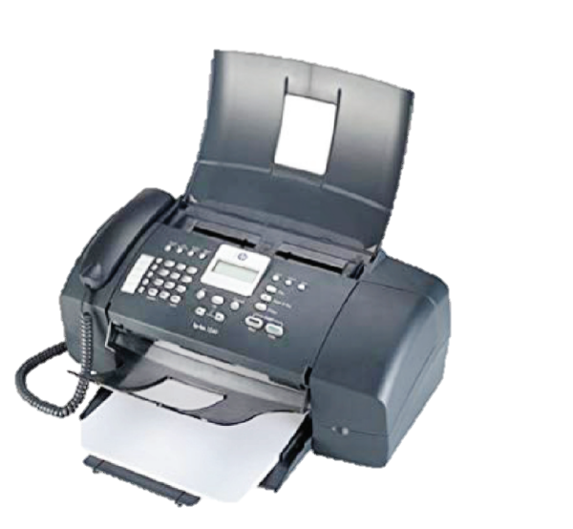
Vocabulary and expression: FAX
Fax machine(n.)
Do you have a fax?
Fax number(n.)
What is your fax number at the office?
Fax message(n.)
Please send me information by fax.
Did you receive my fax?
Fax (v.)(to send somebody a message by a fax machine)
Could you please fax me your new address?

Slide 5
Writing dates
American English & British English

Slide 6
Saying Dates

Slide 7
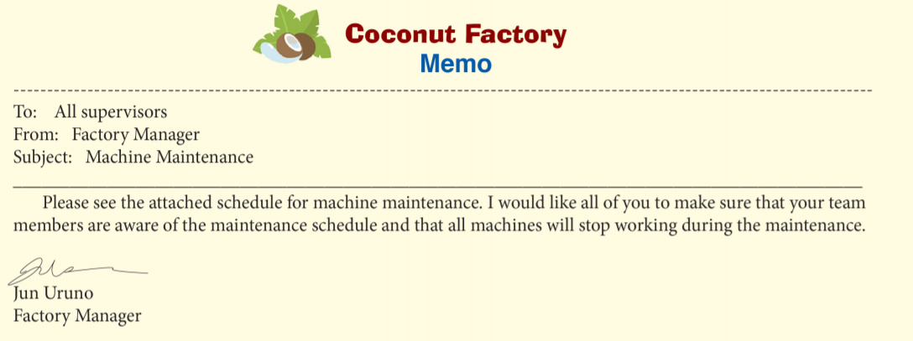
Memorandum
Elements of Memo
Receiver
Name of a company
Sender
Topic of memo
Body of memo
Sender’s name and job position

Slide 8
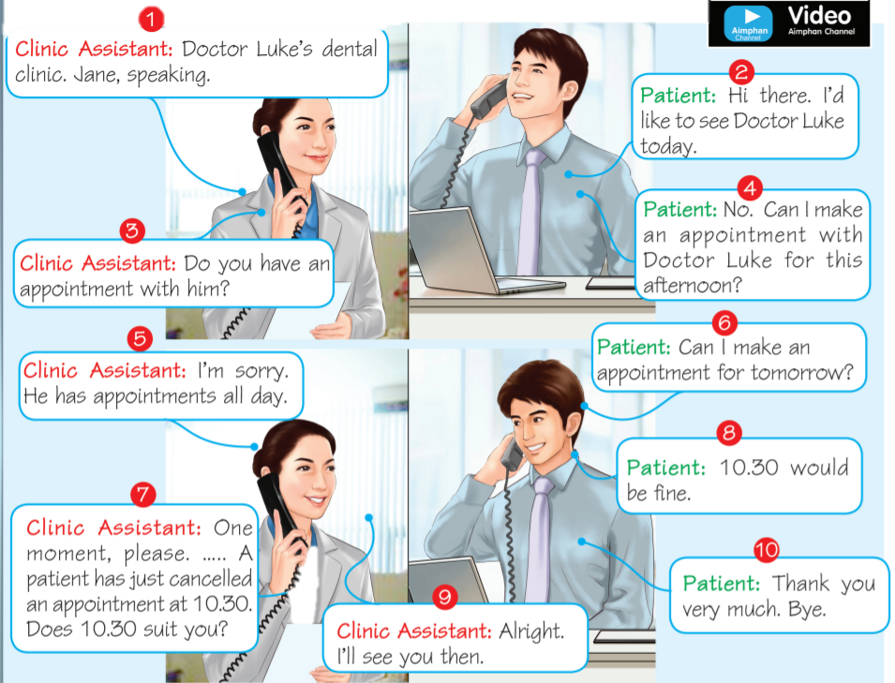
Conversation: Making an appointment(1)

Slide 9
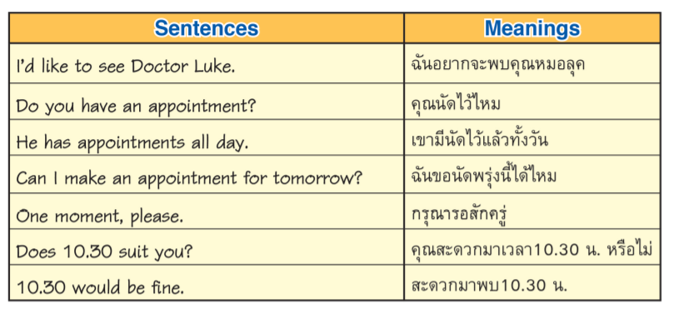
Expression: Making an appointment(2)

Slide 10
Communication problems on the phone(1)

Slide 11
Communication problems on the phone(2)

Slide 12
Communication problems on the phone(3)

Slide 13
Web Search Engine or simply search engine is a computer program that helps you look for information on the Internet. The online search stars with going to one of the web search engine and typing in the words we are going to find. Then, that web search engine will search for content related to your word search.

Slide 14
How to use a Web Search Engine

Slide 15
How to use a Web Search Engine

Slide 16
Messenger Application Line

Slide 17
Messenger Application
WhatsApp

