Slide 1
UNIT 3
- - - -
Descriptions
- - - - - - - - -
สาระการเรียนรู้
1. การอธิบายขนาด (แบบมีเบอร์) รูปร่าง และสี
2. การสนทนาเรื่องเครื่องมือวัดทางไฟฟ้า
3. คำศัพท์เกี่ยวกับเครื่องมือช่างพื้นฐาน
4. การถามตอบเกี่ยวกับวัตถุประสงค์ในการใช้
5. ความแตกต่างระหว่างเลื่อยสองชนิด
6. การแสดงหลักฐานการเรียนรู้ด้วยตนเอง และการใช้
เทคโนโลยีสารสนเทศสืบค้นและฝึกฝนการใช้ภาษาอังกฤษ

Slide 2
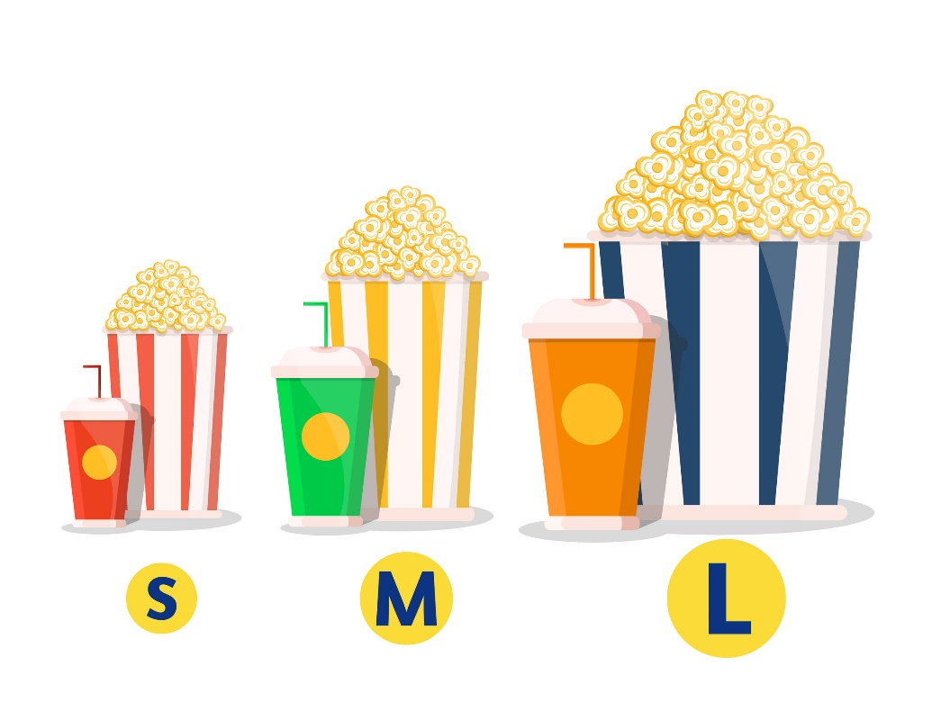
Activity 1 Starting Up
Practice A Match these abbreviations used on clothes with their size.
S M L XL
___ small ___ medium
___ large ___ extra large
Practice B From Practice A, which size is used on clothes to mean an average size?

Slide 3
Practice C Translate these sentence into the Thai language.
1. The T-shirts come in four size: small, medium, large and extra large.
2. What size shoes do you wear?
Practice D Match the objects with the shapes.

Slide 4
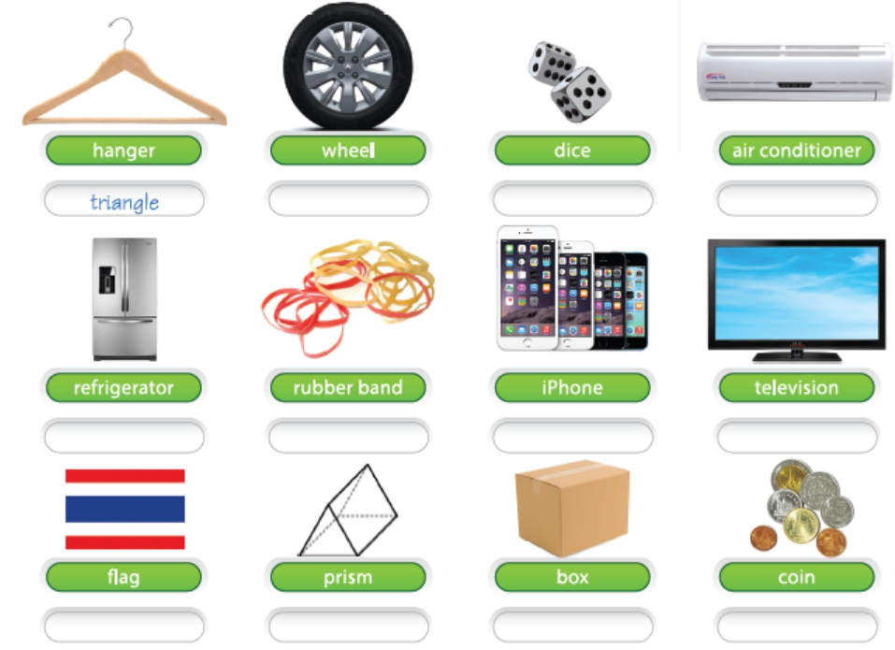

Slide 5
Practice E Make sentences asking about the color of things. Then make answer to the questions.
Question : What color is your car.
Answer : My car is white.

Slide 6
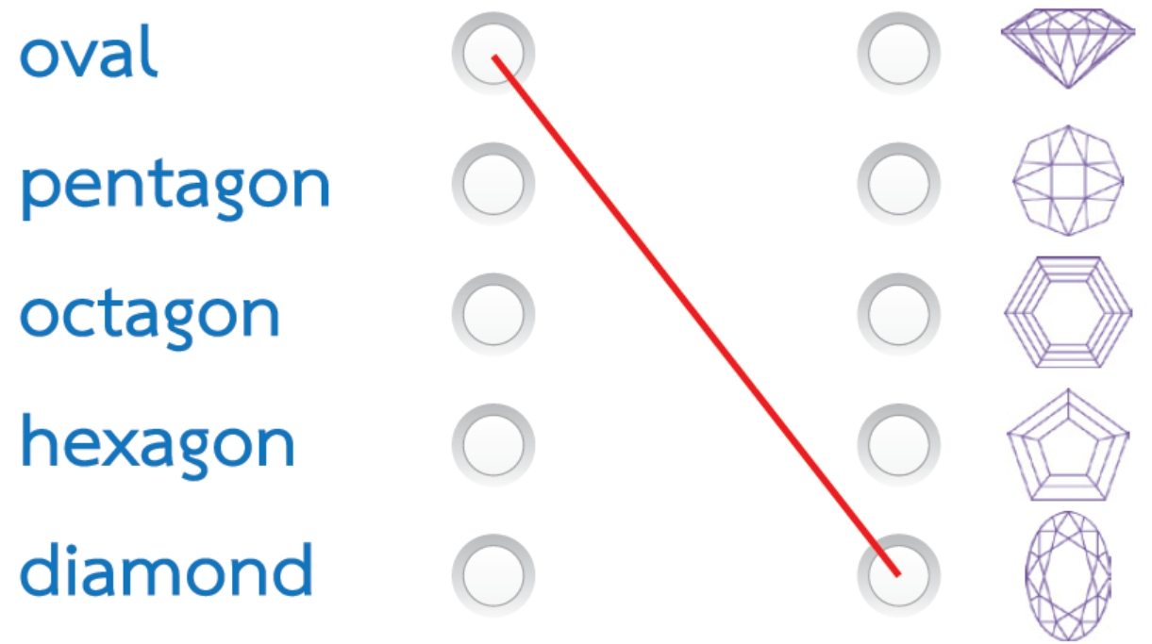
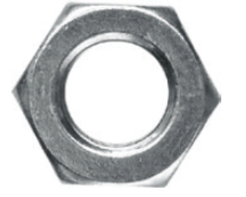
Practice F There are many other shapes around us. Match the words on the left with the pictures on the right.
Practice G What shape is this object?

Slide 7
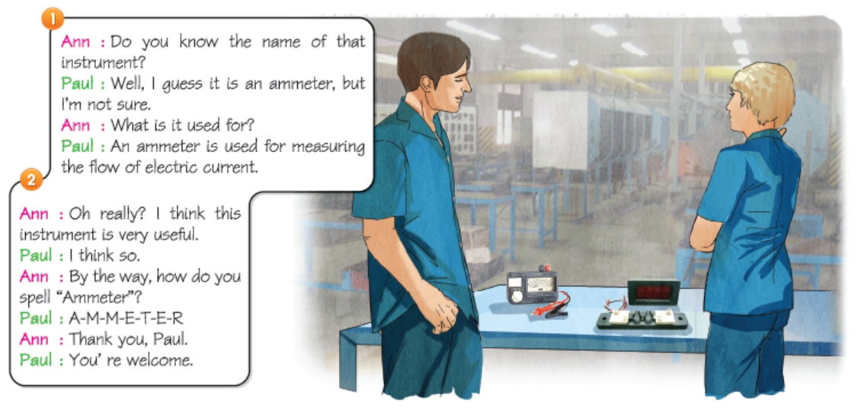
Activity 2 Listening & Speaking
Practice A Listen to their conversation.

Slide 8
Practice B What is an ammeter used for?
Practice C
What is the name of the unit of the measurement from an ammeter? Discuss the answer with your friends.

Slide 9
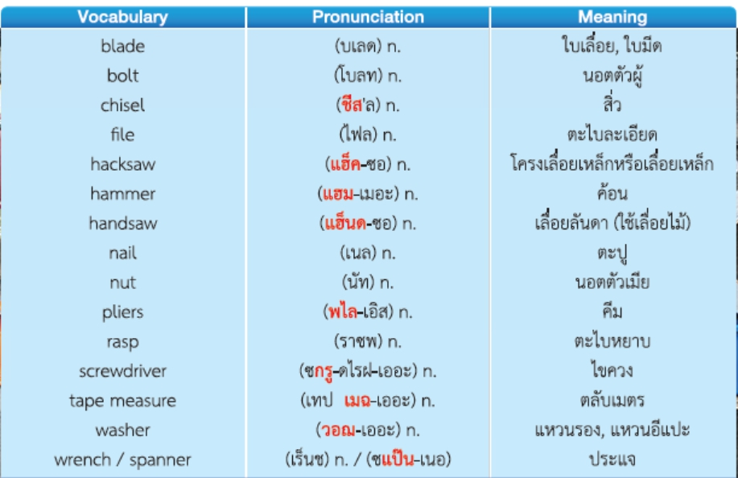
Activity 3 Vocabulary
Practice A Learn and repeat the words about tools after the CD.

Slide 10
Practice A Learn and repeat the words about tools after the CD.

Slide 11
Practice B Write the name of each of the following tools.

Slide 12
Activity 4 Language Focus
การถามเกี่ยวกับวัตถุประสงค์ในการใช้
“What I it used for?” เป็นประโยคใช้เพื่อถามว่า “มันใช้ทำอะไร” ลักษณะการตอบจะมีอยู่ 2 แบบ คือ “It is used for Ving” หรือ “It is used to V1”
ตัวอย่างประโยค
Q : What is a multimeter used for?
A : It is used for measuring electric current, resistance and voltage.
A : It is used to measure electric current, resistance and voltage.

Slide 13
Practice A Rewrite the following sentences in the form of It is used to V1

Slide 16
Activity 5 Reading & Writing
Practice A Read the differences between a hacksaw and a handsaw. Then answer the questions in Practice B.
Practice B Write a short answers to these questions.
1. How many hands do we usually use with a hacksaw?
2. How many differences are there between a hacksaw and a handsaw?

Slide 17
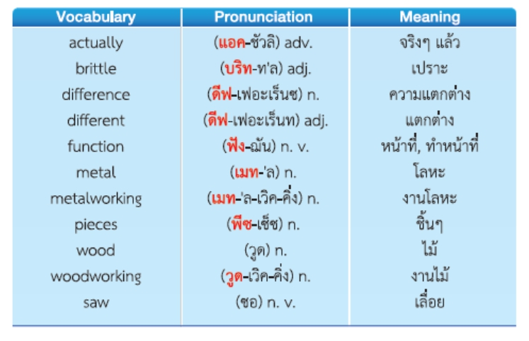
Practice C Review the following vocabulary from the passage Hacksaw and Handsaw.

Slide 18
Practice D Underline the words in brackets to complete these sentences.
1. We saw wood with a ___. (hacksaw / handsaw)
2. We saw metal with a ___. (hacksaw / handsaw)
3. The blade of a hacksaw is quite ___. (brittle / durable)
4. The blade of a handsaw is quite ___. (brittle / durable)
5. A handsaw does not have a ___. (frame / shape)
6. We use ___ hands with a hacksaw. (one / both)

Slide 19
7. We use ___ hand with a handsaw. (one / both)
8. The blade of a hacksaw is ___ than the blade
of a handsaw. (bigger / smaller)
9. The word “___” means hard but easily broken. (brittle / sharp)
10. Woodworking is the activity of making ___ objects. (metal / wooden)
11. Metalworking is the activity of making thing out of ___. (metal / wood)
12. ___ is a solid material which is typically hard and shiny. (Metal / Wood)

Slide 20
Activity 6 Progress Check & Independent Study
Check A Complete the question and answer.
Question : _____________________________
Answer : It’s shape is like a rectangle.
a. What color is it?
b. What shape is it?
c. What size is it?
d. What size are you?

Slide 21
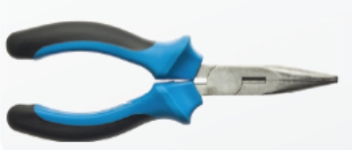
Check B What do you call this tool?
Check C What is a screwdriver used for?
Check D What are the differences between a hacksaw and a handsaw?

